Slide 1


Presenting to ---
MD Khademul Islam Sir Lecturer of English Uttara University
Presenting by ---
MD Ibrahim Shimul ID: 2222081081 Section – 57B Day Department of CSE
HELLO
EVERYBODY
WELCOME

Slide 2
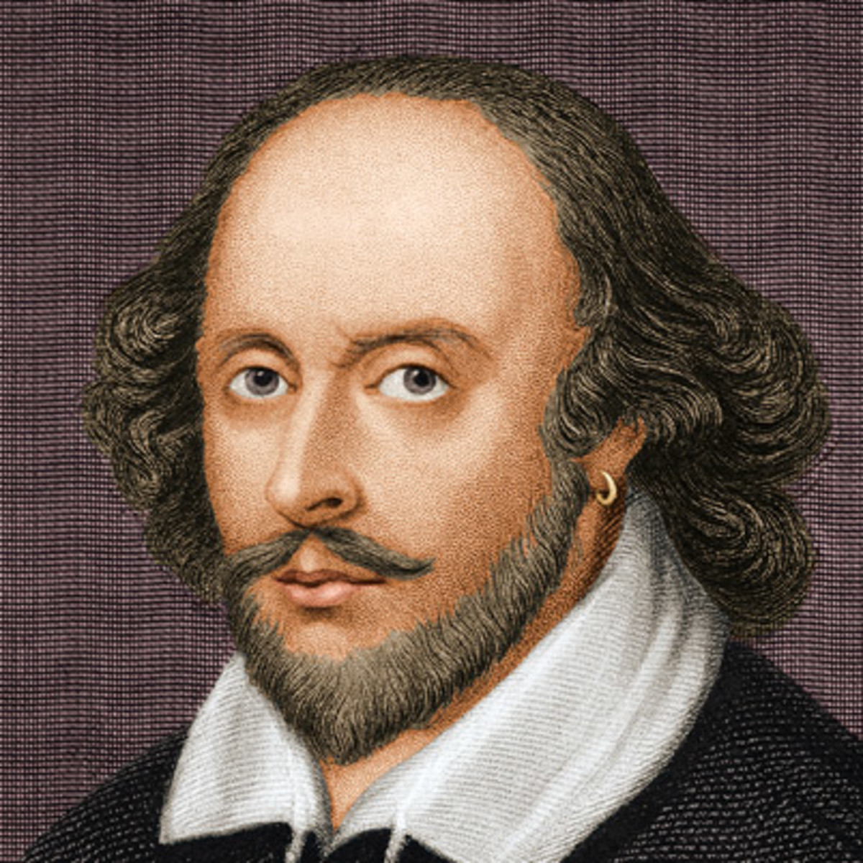
02
WILLIAM SHAKESPEARE

Slide 3
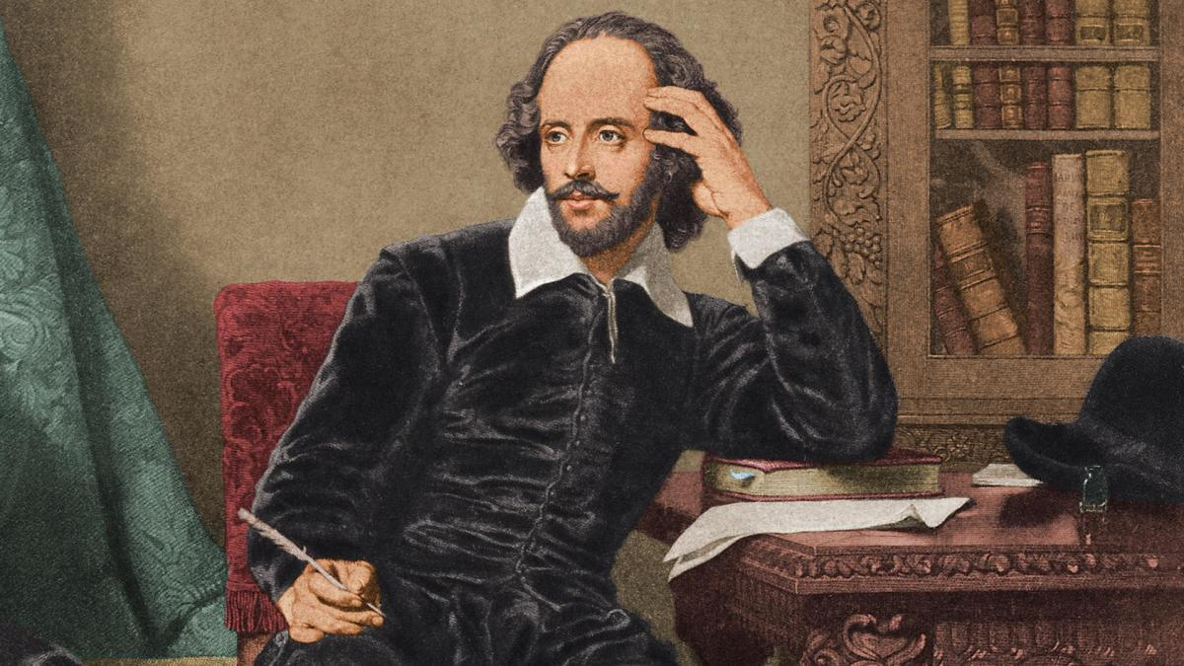
WILLIAM SHAKESPEARE
03
William Shakespeare was an English playwright, poet and actor. He was widely regarded as the greatest writer in English language and the world’s greatest dramatist.
WILLIAM SHAKESPEARE

Slide 4
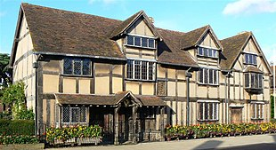
WILLIAM SHAKESPEARE
04
He was born in 26th April, 1564 in Stratford-Upon-Avon, England. He was the 3rd child of 8 children of his family. His father’s name is John Shakespeare and mother’s name is Mary Arden.
BIRTHPLACE OF SHAKESPEARE

Slide 5
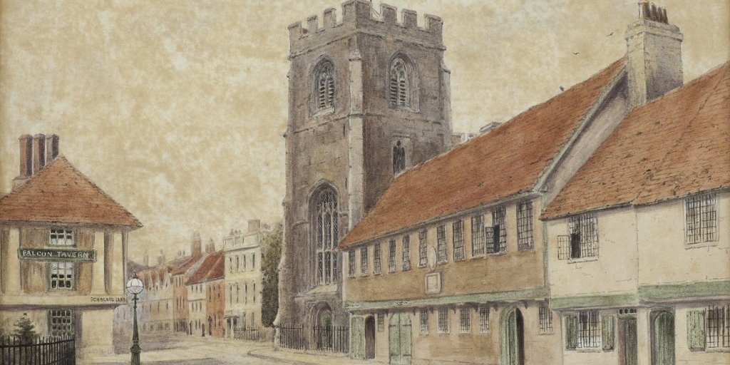
WILLIAM SHAKESPEARE
05
No school records have been ever found, but it is likely that he attended the local grammar school, King’s new school, which emphasized a liberal arts education. He received excellent education with heavy focus on grammar and literature.
Shakespeare’s Grammer School

Slide 6
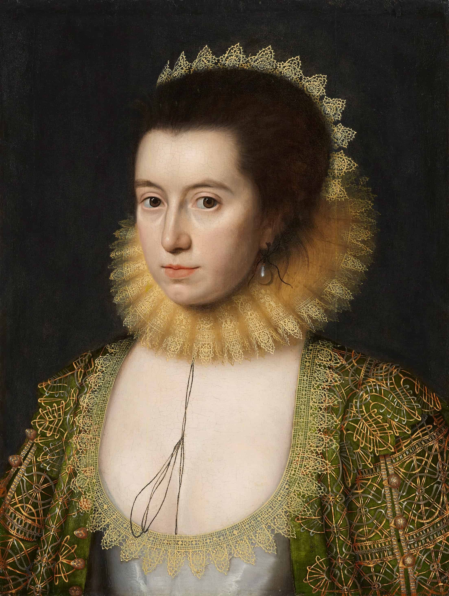
WILLIAM SHAKESPEARE
06
In 1582, William Shakespeare married at age 18 to Anne Hathaway, who was pregnant with his child. She was 26 at that time.
Shakespeare’s Wife

Slide 7
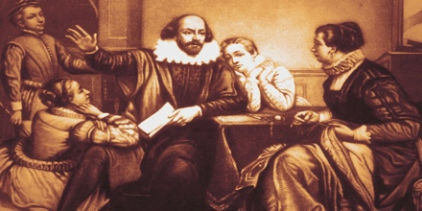
WILLIAM SHAKESPEARE
07
They had 3 children. They are- Susanna Hall, Hamnet Shakespeare, Judith Quiney. Susanna Hall was the first child. Hamnet Shakespeare and Judith Quiney were born as twin.
Shakespeare’s Family

Slide 8
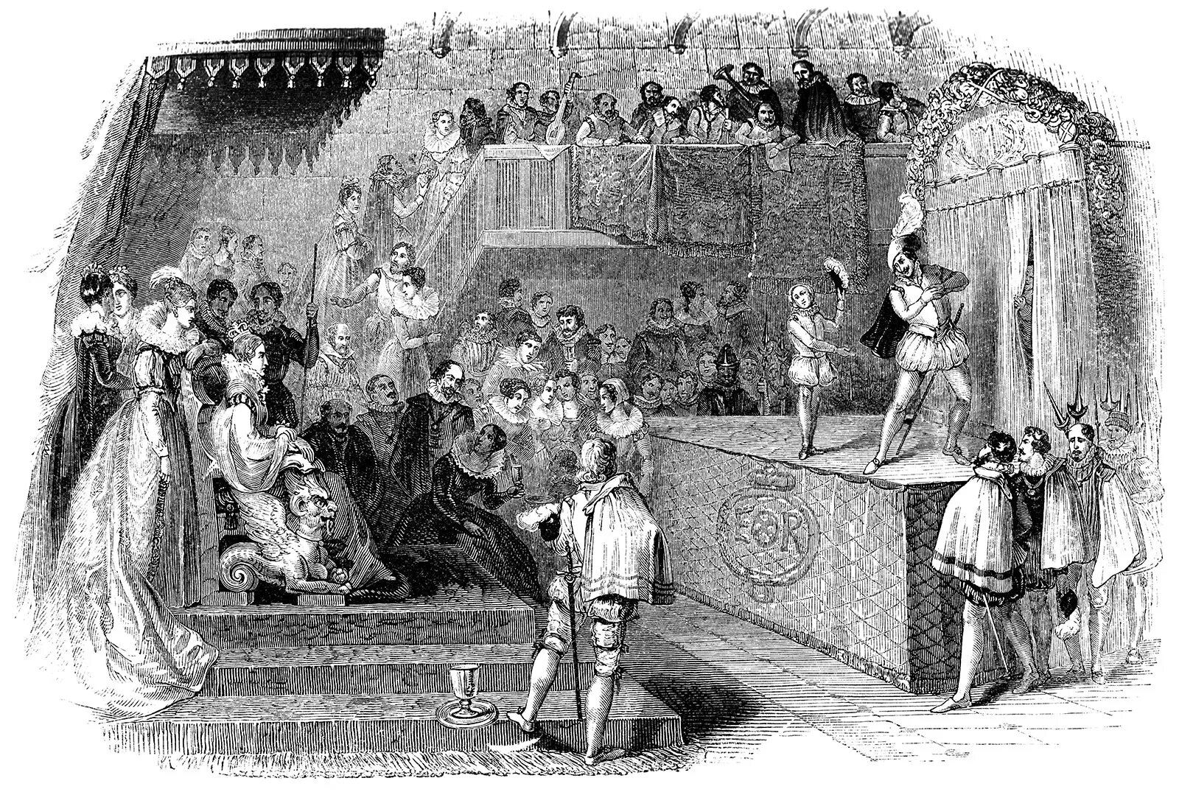
WILLIAM SHAKESPEARE
08
He moved in London around 1591 and become an actor. He worked with the Lord Chamberlin’s company of players, later known as the King’s Men.
Lord Chamberlin’s Men

Slide 9

WILLIAM SHAKESPEARE
09
Along with acting, he also wrote some of his most renowned literature, poems and plays- comedies, tragedies, histories.
Shakespeare’s Famous Books

Slide 10
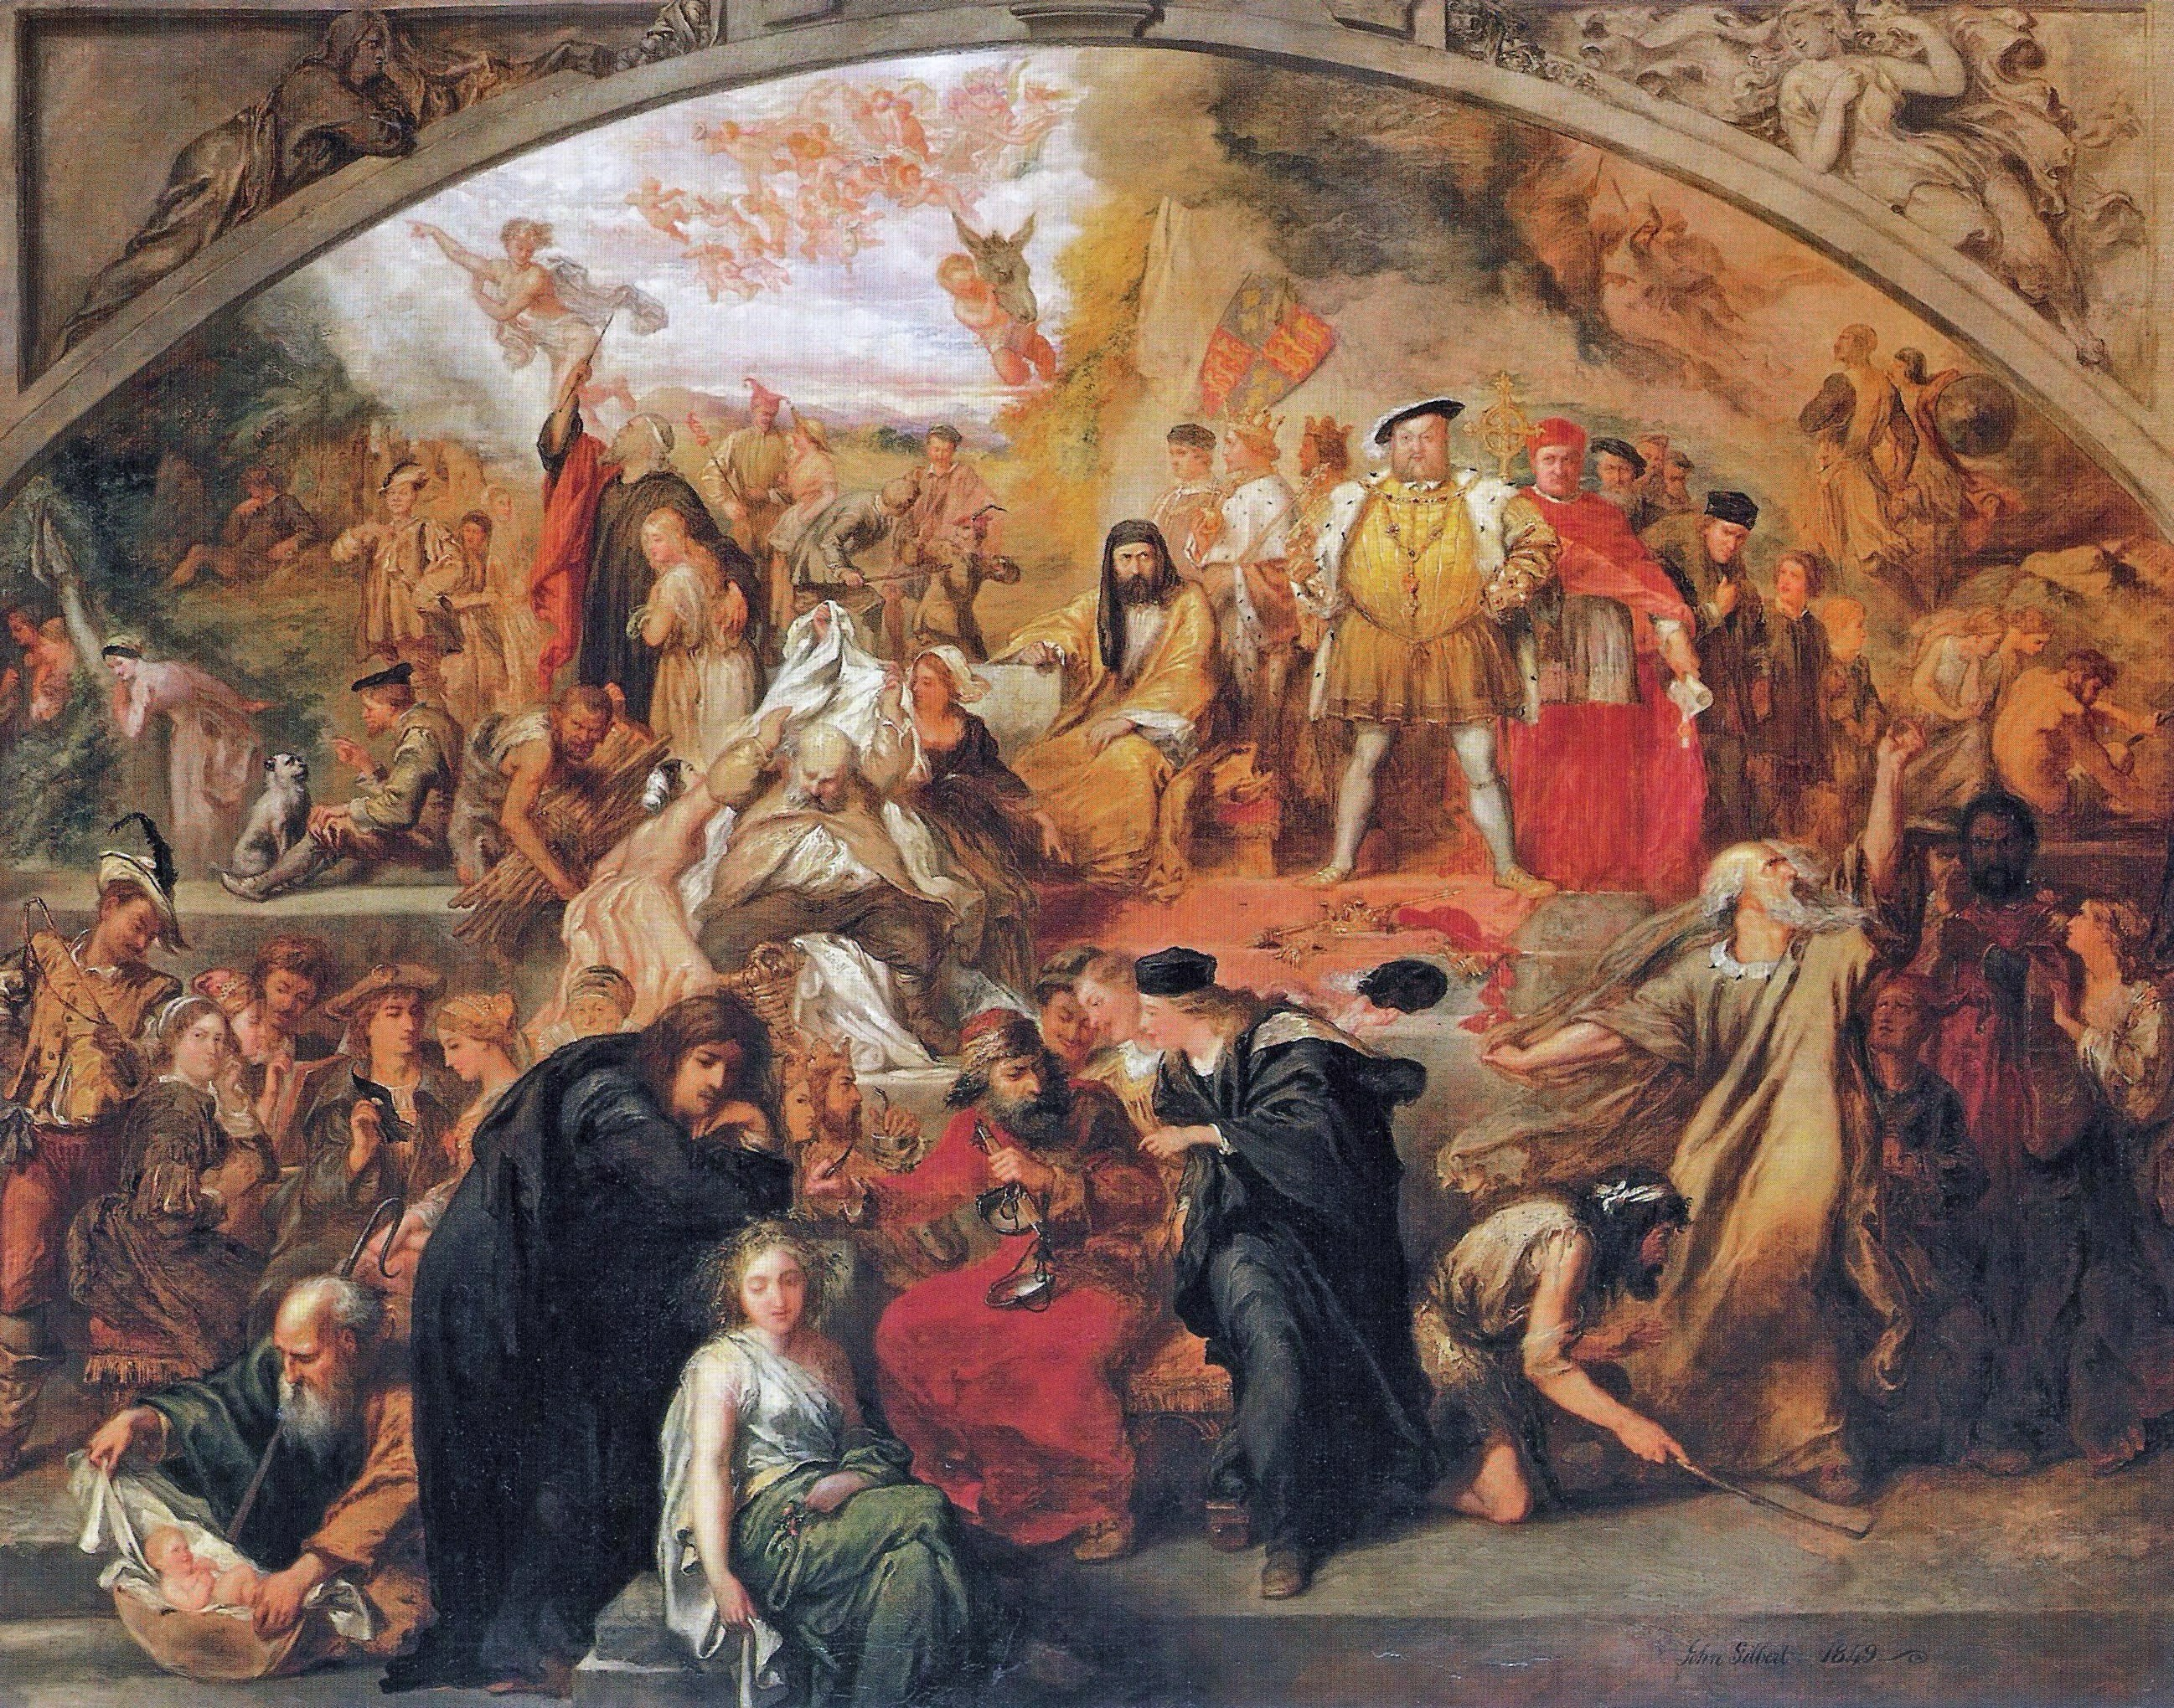
WILLIAM SHAKESPEARE
10
He wrote 37 very successful plays. Some of his comedies are-
• All’s Well That Ends Well
• As You Like It
• Comedy of Error
• Measure of Measure
• Merchant of Venice
Shakespeare’s Plays

Slide 11
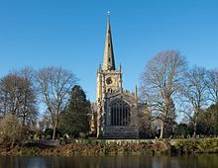
WILLIAM SHAKESPEARE
11
In 23th April, 1616, at the age of 52, he died. His death was mystery. It is rumored that he drank too much and contracted a fever or that he died from a cerebral hemorrhage.
Holy Trinity Church, where Shakespeare was baptised and is buried

Slide 12
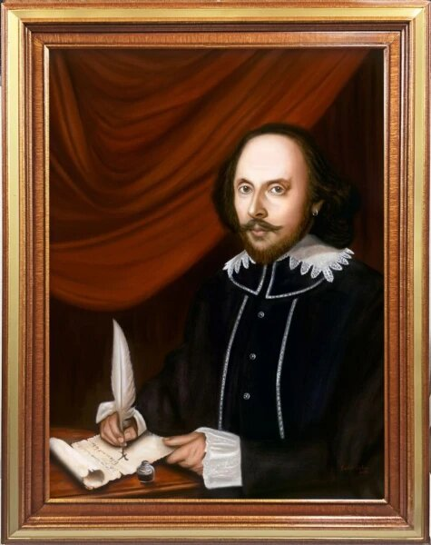
We always remember this legend with honor, as he was the greatest literature and actor.

Slide 13
THANK YOU
EVERYBODY
Have any question?
Ask Me

